Slide 1
MODULE 11: HYPOTHERMIA PREVENTION
TCCC TIER 1
All Service Members
TCCC TIER 2
Combat Lifesaver
TCCC TIER 3
Combat Medic/Corpsman
TCCC TIER 4
Combat Paramedic/Provider

Slide 2




TACTICAL COMBAT CASUALTY CARE (TCCC) ROLE-BASED TRAINING SPECTRUM
ROLE 1 CARE
NONMEDICAL PERSONNEL
MEDICAL PERSONNEL
ASM
CMC
CPP
CLS
YOU ARE HERE
STANDARDIZED JOINT CURRICULUM

Slide 3





TERMINAL LEARNING OBJECTIVE
STUDENT LEARNING OBJECTIVES
12 Given a combat or noncombat scenario, perform hypothermia prevention measures on a trauma casualty during Tactical Field Care and Tactical Evacuation Care in accordance with CoTCCC Guidelines
Identify the progressive strategies, indications, and limitations of hypothermia prevention of a trauma casualty In Tactical Field Care
Demonstrate active external warming hypothermia prevention measures on a trauma casualty
Identify passive hypothermia prevention measures on a trauma casualty
3
ENABLING LEARNING OBJECTIVES (ELOs)
= Cognitive ELOs
= Performance ELOs

Slide 4


MARCH PAWS
TACTICAL FIELD CARE
DURING LIFE-THREATENING AFTER LIFE-THREATENING
M A R C H
MASSIVE BLEEDING
#1 Priority
P
PAIN
AIRWAY
A
ANTIBIOTICS
R RESPIRATION (breathing)
C CIRCULATION
_{H} HYPOTHERMIA/ HEAD INJURIES
W
WOUNDS
S
SPLINTING

Slide 5

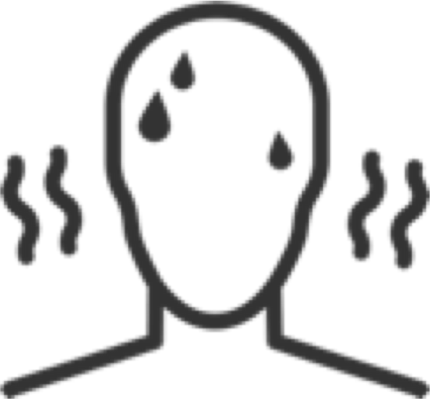

HYPOTHERMIA PREVENTION
HYPOTHERMIA
Hypothermia is the decrease in body temperature
Even a small decrease in body temperature can interfere with blood clotting and increase the risk of bleeding to death
Casualties in shock are unable to generate body heat effectively
Hypothermia is a problem for casualties with hemorrhagic shock, even with warm, ambient temperatures
IMPORTANT CONSIDERATIONS:
A lower body temperature may not be an indicator of hypothermia; it may be due to exposure to a cold environment
M A R C H

Slide 6
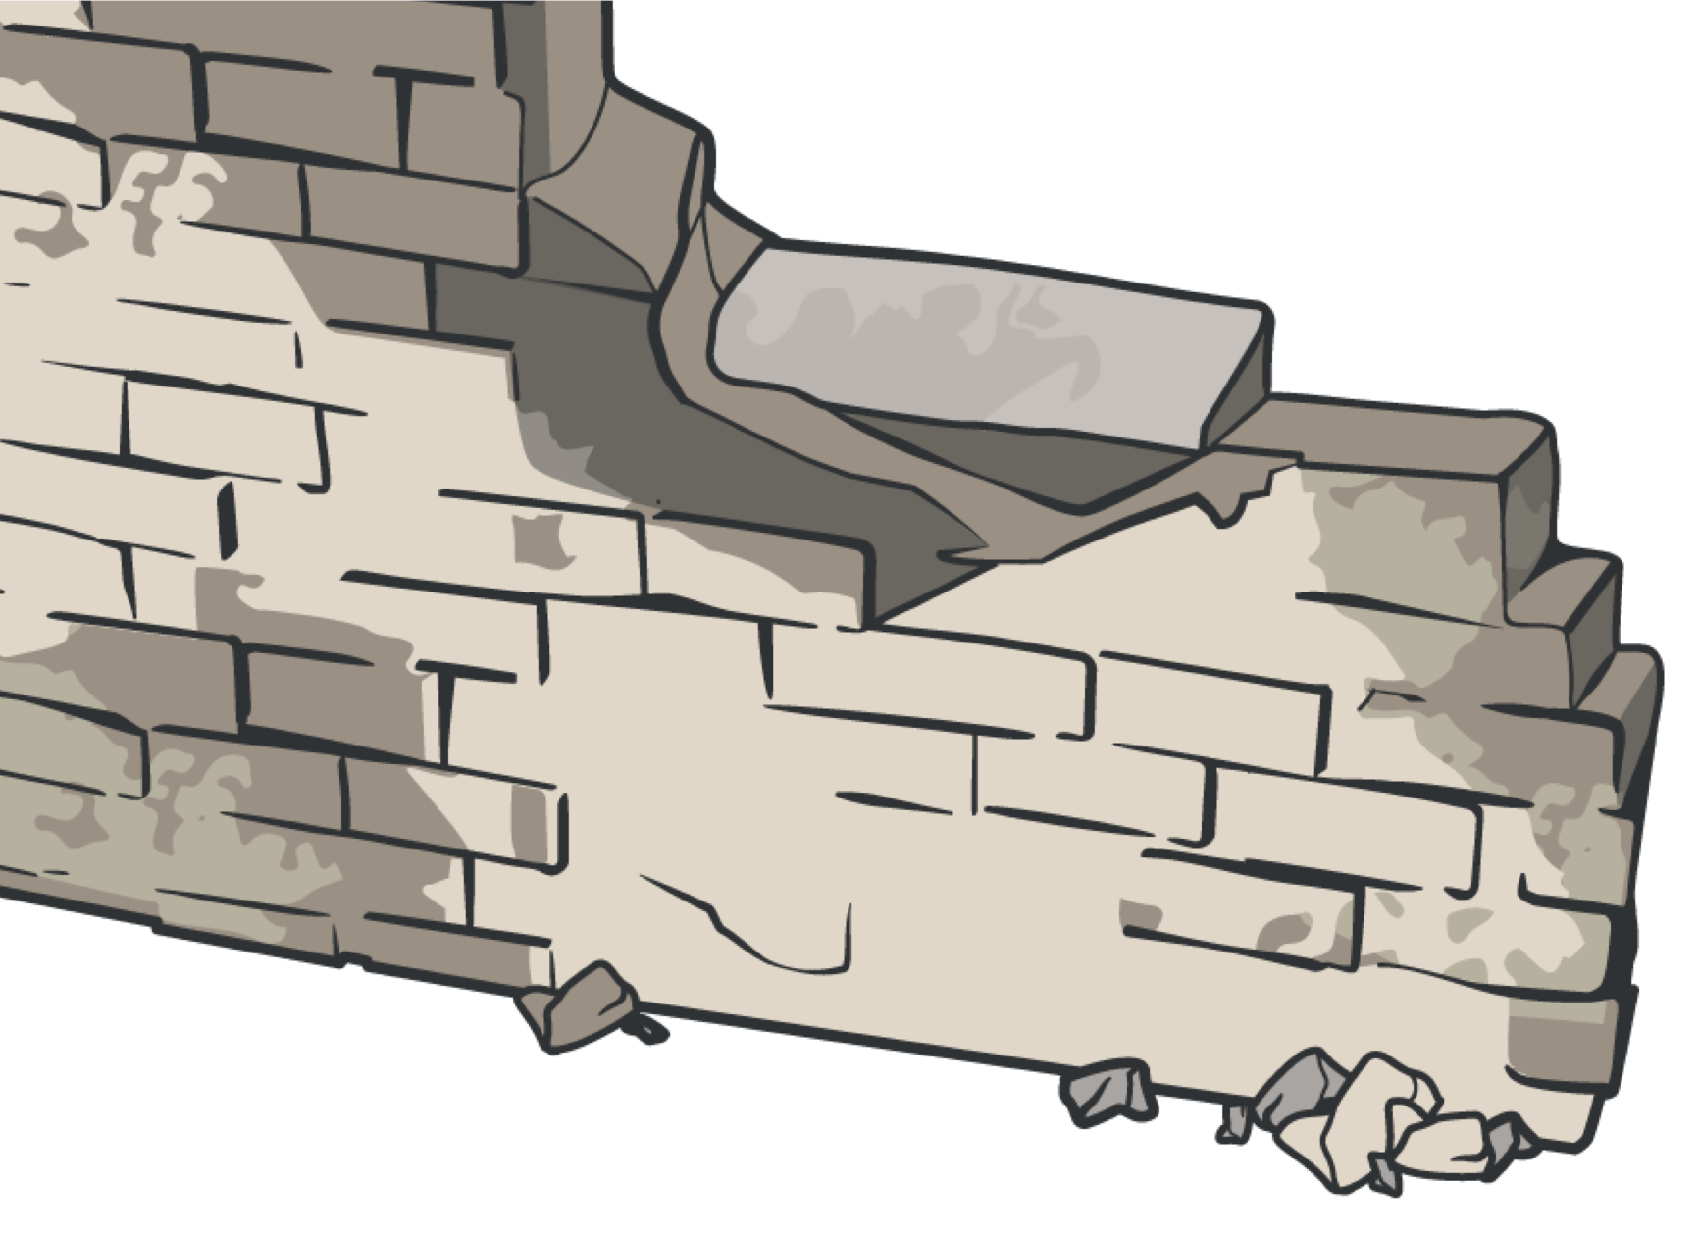
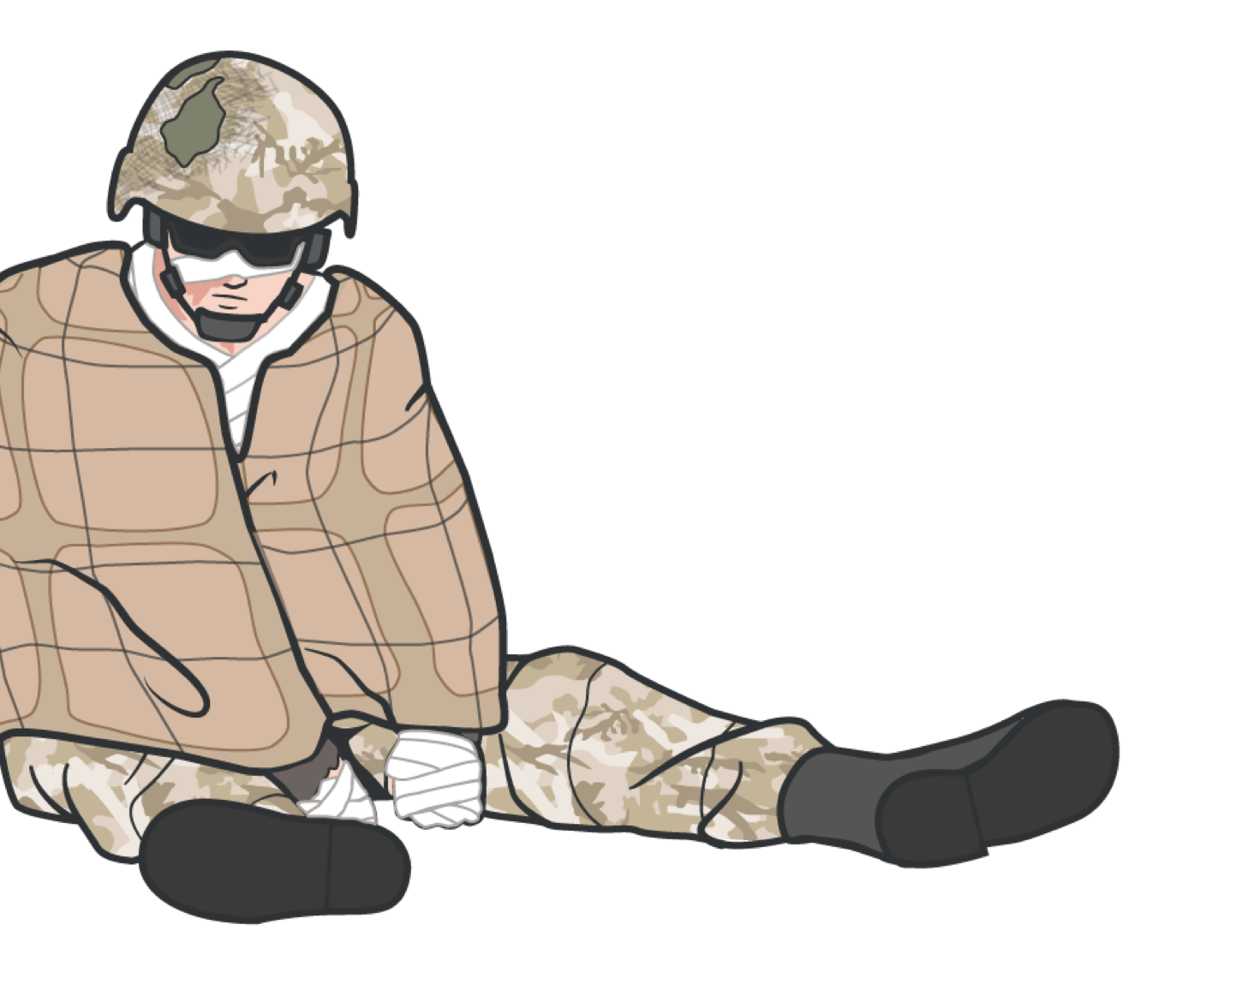
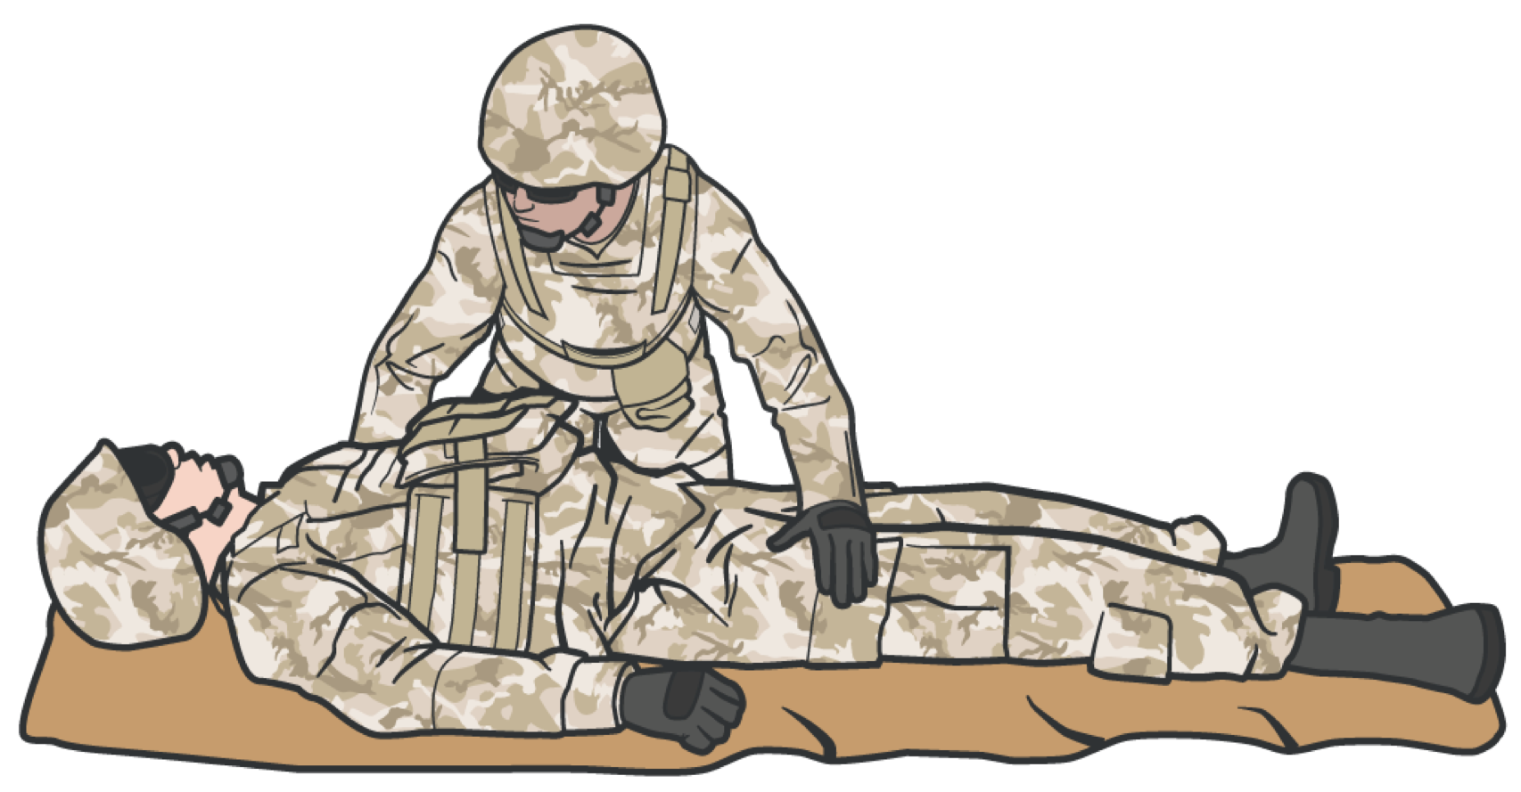

HYPOTHERMIA
HYPOTHERMIA PREVENTION
Minimize the casualty’s exposure to the elements
Keep protective gear on or with the casualty if feasible
Replace wet clothing with dry, if possible
You can better prevent hypothermia by getting the casualty onto an insulated surface as soon as possible

Slide 7

HYPOTHERMIA PREVENTION
HYPOTHERMIA
Hypothermia is much easier to prevent than to treat Begin hypothermia prevention as soon as possible
Decreased body temperature interferes with blood clotting and increases the risk of bleeding
Blood loss can cause a significant drop in body temperature, even in hot weather
Get the casualty onto an insulated surface as soon as possible.
M A R C H

Slide 8
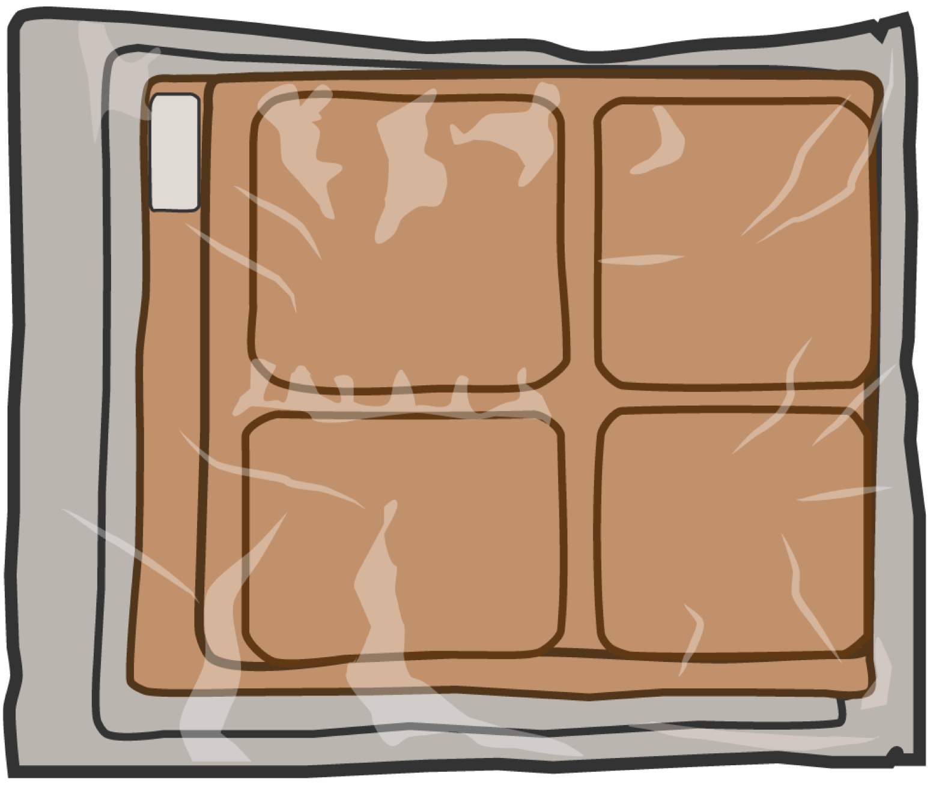
ACTIVE HYPOTHERMIA BLANKETS
HYPOTHERMIA
Your medical personnel will distribute the active hypothermia blankets based on unit mission and load
Active hypothermia blankets are activated when their heating elements are exposed to air
Active hypothermia blankets are applied to a casualty who cannot generate their own heat, but not directly on their skin because the activated blankets can cause burns
M A R C H

Slide 9
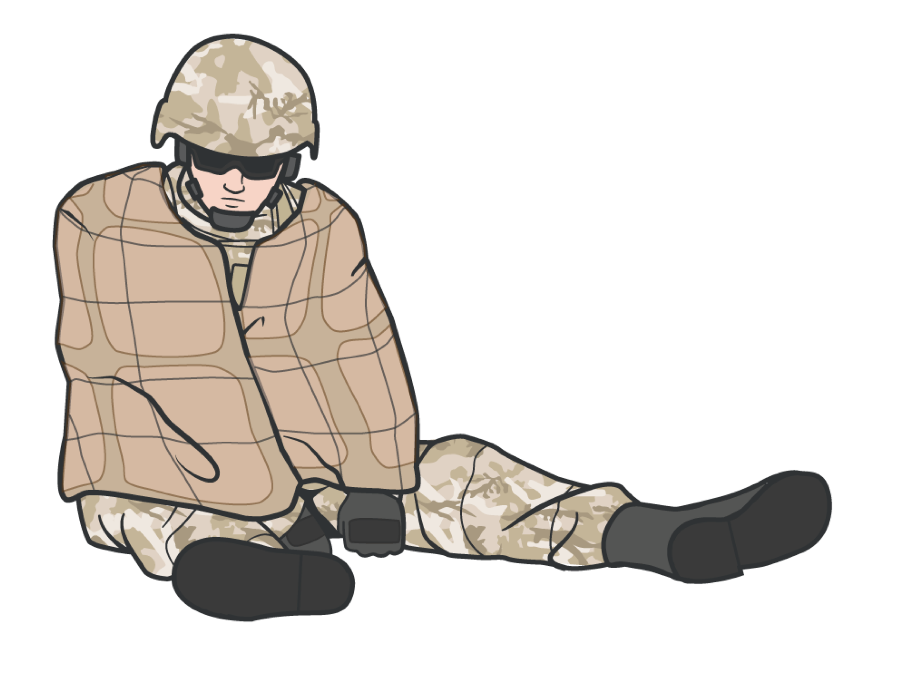

ACTIVE HYPOTHERMIA MANAGEMENT
HYPOTHERMIA
KEY POINTS
▪
If an active hypothermia blanket is not available, a combination of the passive warming blanket and an active warming blanket may also be used
Active hypothermia treatment uses heating sources to warm the casualty
Oxygen levels at higher altitudes may not be enough to sustain the chemical reaction required to generate heat
Apply the active warming blanket from the active hypothermia blanket to the casualty’s torso (not directly on the skin), and cover the casualty with the passive hypothermia shell
▪
M A R C H

Slide 10
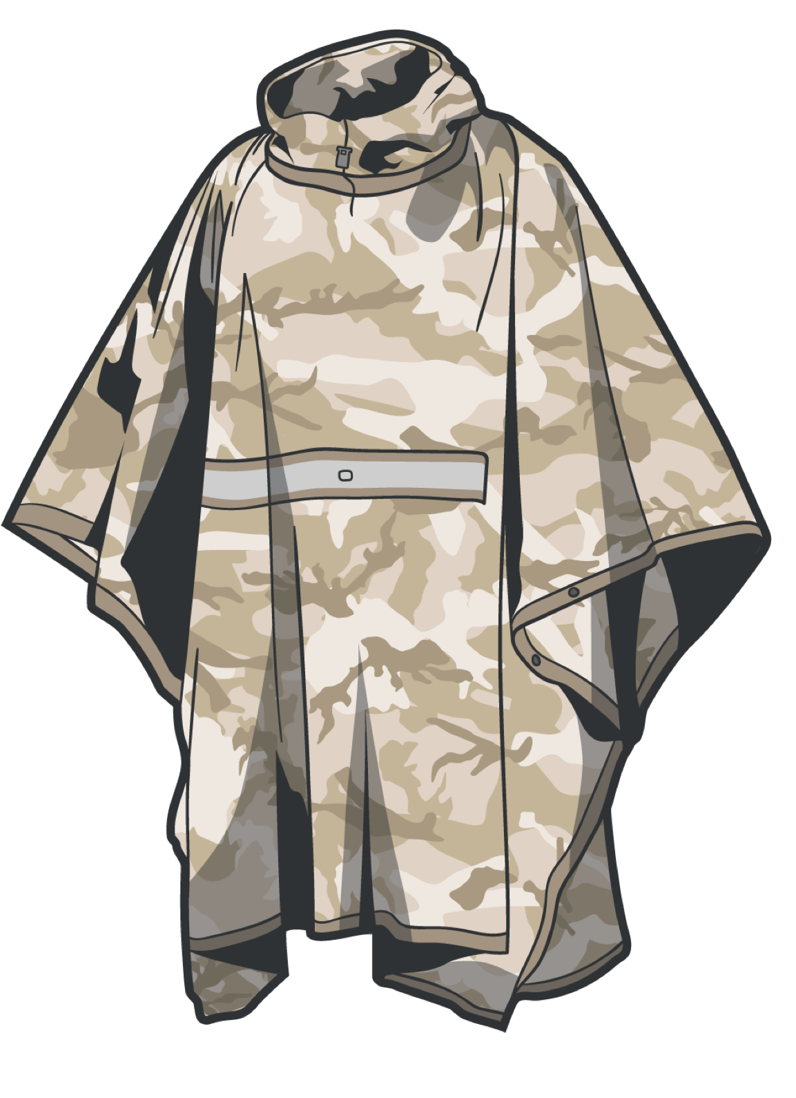
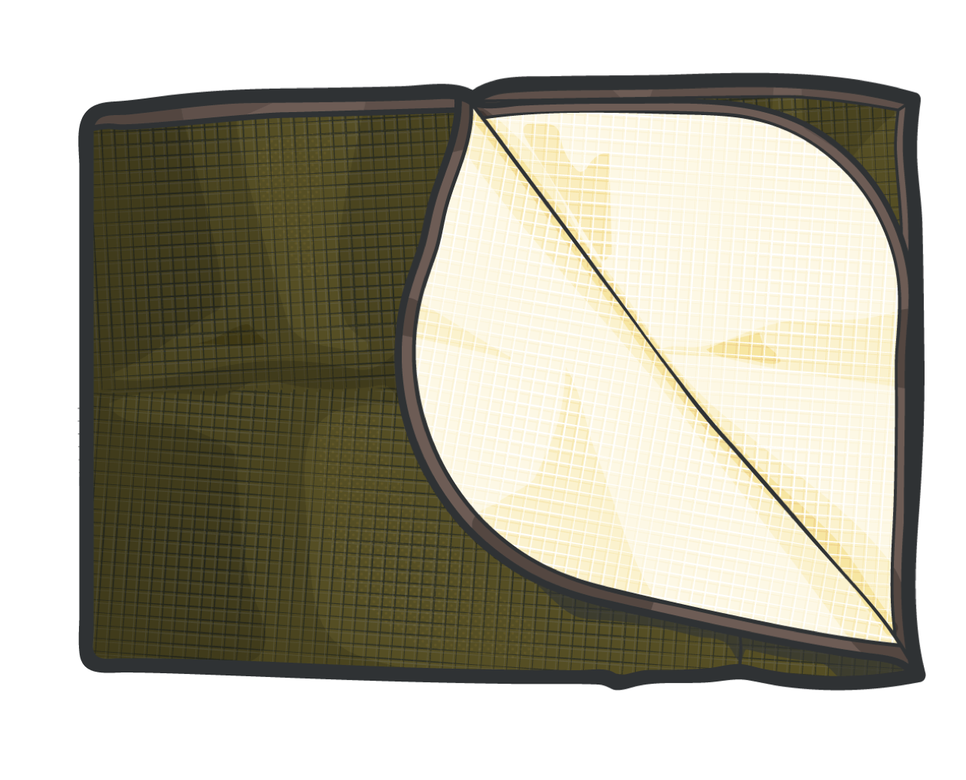
PASSIVE HYPOTHERMIA MATERIALS
HYPOTHERMIA
Passive hypothermia materials provide heating by:
Keeping the casualty’s body heat contained in the passive material
Keeping the casualty off the ground
M A R C H

Slide 11
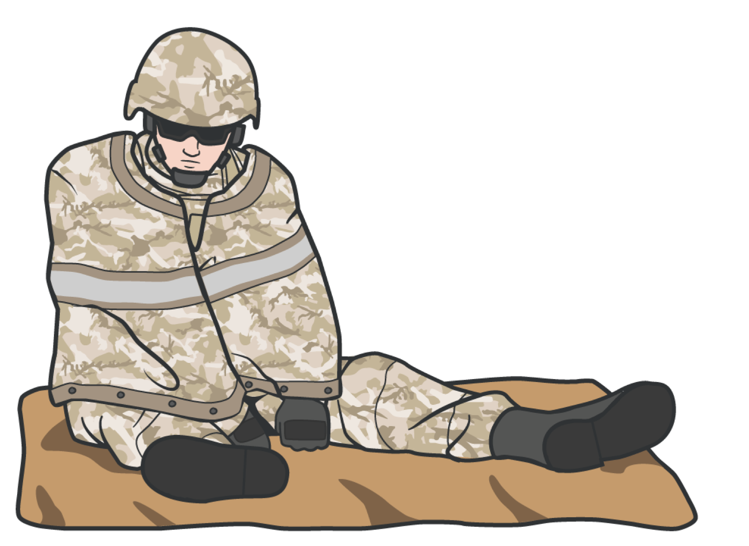
PASSIVE HYPOTHERMIA MANAGEMENT
HYPOTHERMIA
Place a poncho or blanket under the casualty to protect them from the temperature or dampness of the ground
Passive hypothermia prevention does not reverse the hypothermic process
If no rewarming equipment is available, then use dry blankets, poncho liners, sleeping bags, or anything that will retain heat and keep the casualty dry
Keep the casualty off the ground
KEY POINTS
Blood loss can cause a significant drop in body temperature, even in hot weather
Wrap the entire blanket-like shell (or passive heating materials) completely around the casualty, including the head
Do not cover the face
M A R C H

Slide 12

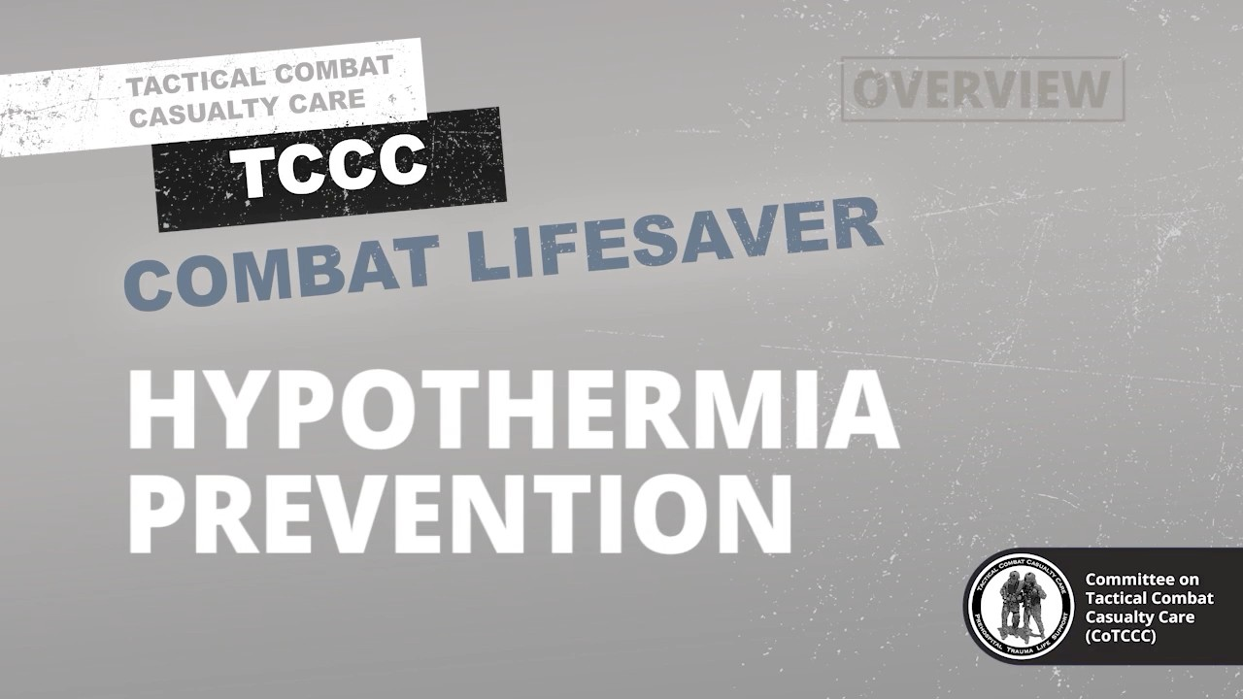
HYPOTHERMIA PREVENTION
HYPOTHERMIA PREVENTION VIDEO
Video can be found on DeployedMedicine.com

Slide 13
HYPOTHERMIA PREVENTION
SKILL STATION
Hypothermia (Skill)
Active/passive external warming hypothermia prevention

Slide 14
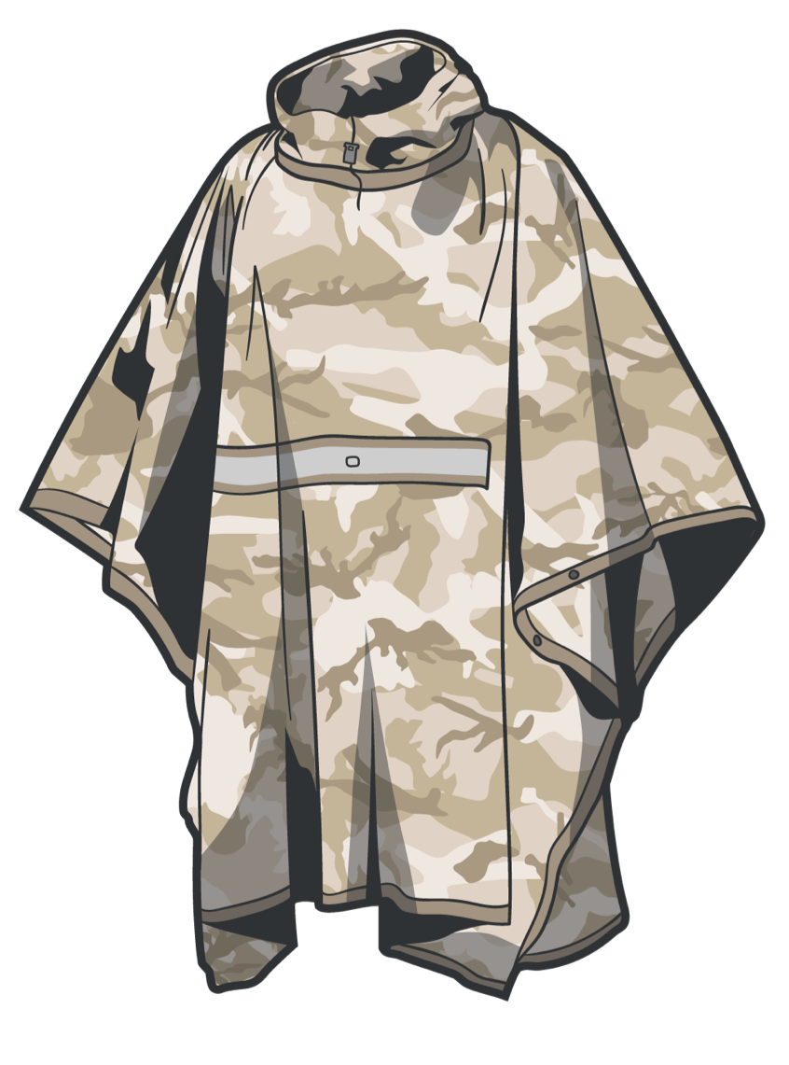
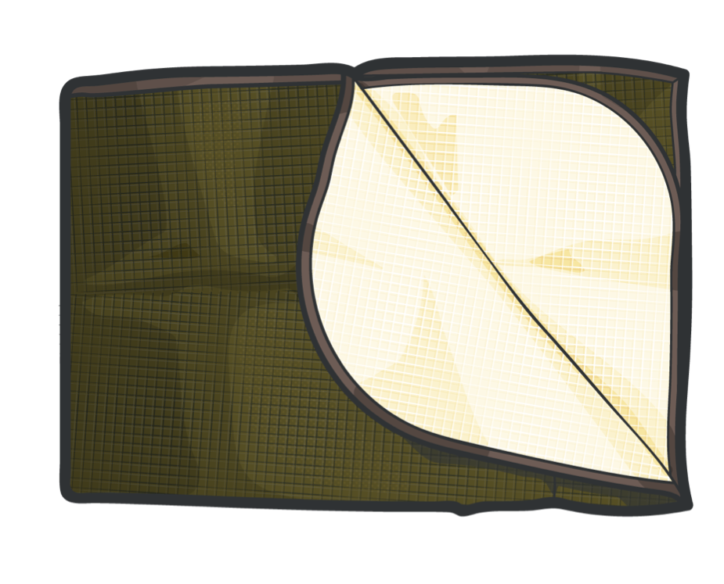


HYPOTHERMIA PREVENTION
SUMMARY
We defined hypothermia
We discussed active hypothermia management/prevention
We discussed passive hypothermia management/prevention
KEY POINTS
Passive hypothermia
prevention DOES NOT reverse the hypothermic process
Active hypothermia, when at high altitudes, may not be enough to sustain the chemical reaction required to generate heat

Slide 15
HYPOTHERMIA PREVENTION
CHECK ON LEARNING
Why is it important to keep a trauma casualty warm even if it is a hot environment?
What is the difference between active and passive hypothermia management?

Slide 16
HYPOTHERMIA PREVENTION
ANY QUESTIONS?

